Slide 1
Master Thesis Video Representation Analysis

Slide 2
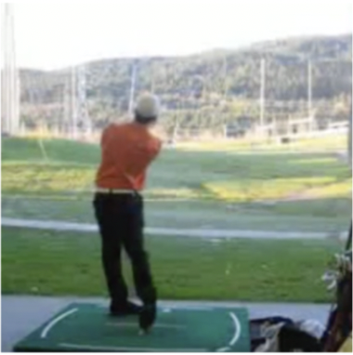
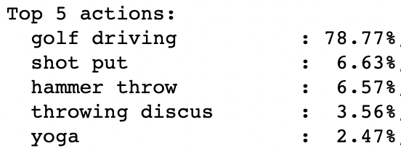
Video Representation Analysis Objectives
Action Classifcation
What information is stored in the internal representations?
Temporal information
Content information (about objects, background etc.)
Differences between training objectives (supervised vs. unsupervised)
Differences between architectures (CNN vs Transformer)
Importance of pre-training dataset (spatially-heavy vs. temporally-heavy)

Slide 3
Video Representation Analysis Objectives
Use video representation of pretrained model for different readout tasks (freeze backbone model & train small network on top)
Temporal Understanding
Object Detection
Segmentation
KNN Classification
…

Slide 4
Video Representation Analysis Analyzed Models
CNN-based
X3D (supervised, 16 input frames)
Slow (supervised, 8 input frames)
Slow-Fast (supervised, two-stream: 8 and 32 input frames)
Transformer-based
VIMPAC (unsupervised, 5 input frames)
MViT (supervised, 16 input frames)
VideoMAE (unsupervised, 16 input frames)

Slide 5
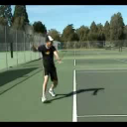
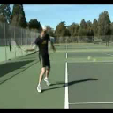
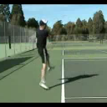
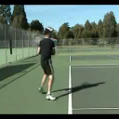
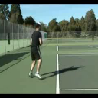
Experiments Temporal Understanding
Original Video
Permutation Prediction (defined as a classifcation task)
3
1
4
5
2

Slide 6

Experiments Temporal Understanding
Reversed (50 % probability for the video to be reversed → classification)
Blackout (predict which frame is blacked-out → classification)
5
4
3
2
1

Slide 7

Experiments Temporal Understanding
Whiteout (predict which frame is whitened-out → classification)
Results:
Permutation & Reverse prediction is not solvable for any model
Unsupervised models perform best in all tasks (particularly well in Blackout / Whiteout)
No difference between MViT and CNN-based models → temporal understanding seems to be subject to training objective, not architecture)
Further ideas: • How does the classifcation performance change for these augmentations? • Is the pre-training dataset relevant for the temporal understanding? (all models pretrained on kinetics-400)

Slide 8
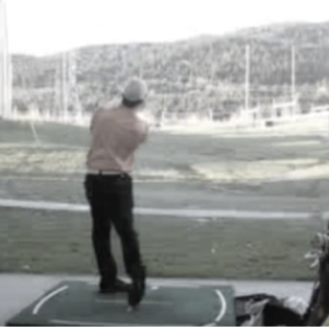
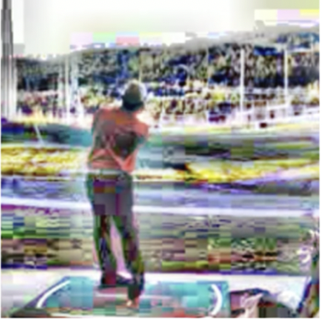
Video Representation Analysis Temporal Understanding: Initial Findings
I3D: Sensitivity towards appearance augmentations (saturation, clahe, …)
Dataset analysis: single frame prediction with Resnet50 (Imagenet pretrained)
Top 1 | 66.8 % (-10.1 %)
Top 3 | 83.9 % (-7.1 %)
Top 5 | 88.9 % (-5.3 %)
Top 1 | 50.9 % (-26.0 %)
Top 3 | 69.8 % (-21.2 %)
Top 5 | 76.5 % (-17.7 %)
Dataset | Top 1 Accuracy (vs. I3D)
HMDB51 | 49.9 % (+0.1 %)
UCF101 | 81.7 % (-2.8 %)
Kinetics400 | 63.0 % (-8.2 %)
S2S | 26.7 % (-48.6 %)

Slide 9
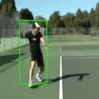
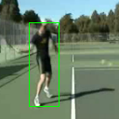
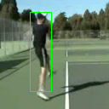
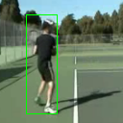
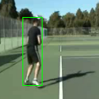
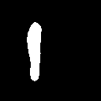
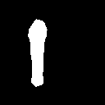
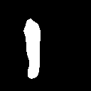
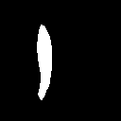
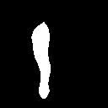
Experiments Content Understanding
Person Detection (on subset of videos with exactly 1 person present in all frames)
Person Segmentation (on subset of videos with exactly 1 person present in all frames)
For both tasks, the prediction of the first / middle / last / all frames was carried out

Slide 10
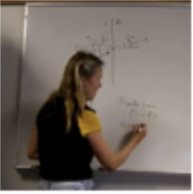

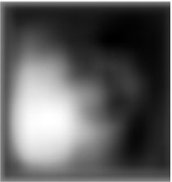

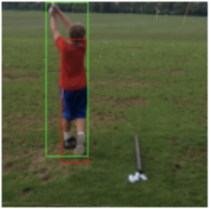
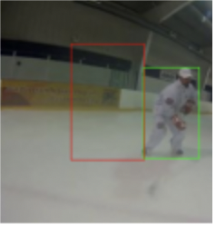
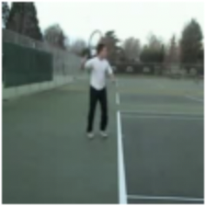

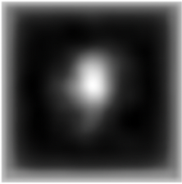
Experiments Content Understanding
Results
CNN-based models perform best. Some examples:
All models show a strong bias to towards a center position → high error for bounding boxes at the sides
Performance varies strongly between video classes (person less relevant for some classes than for others?)
Further ideas: • compare classification performance when removing bbox/segmentation mask and the background • label other relevant features (guitar, basketball etc.)

Slide 11
Experiments KNN Classification and Visualization
Generation of 2D representations with ScaNN (Google Research)
Compare classification performance based on nearest neighbors
As expected, supervised models perform much better
VideoMAE significantly better than VIMPAC
Visualization with t-sne

Slide 12
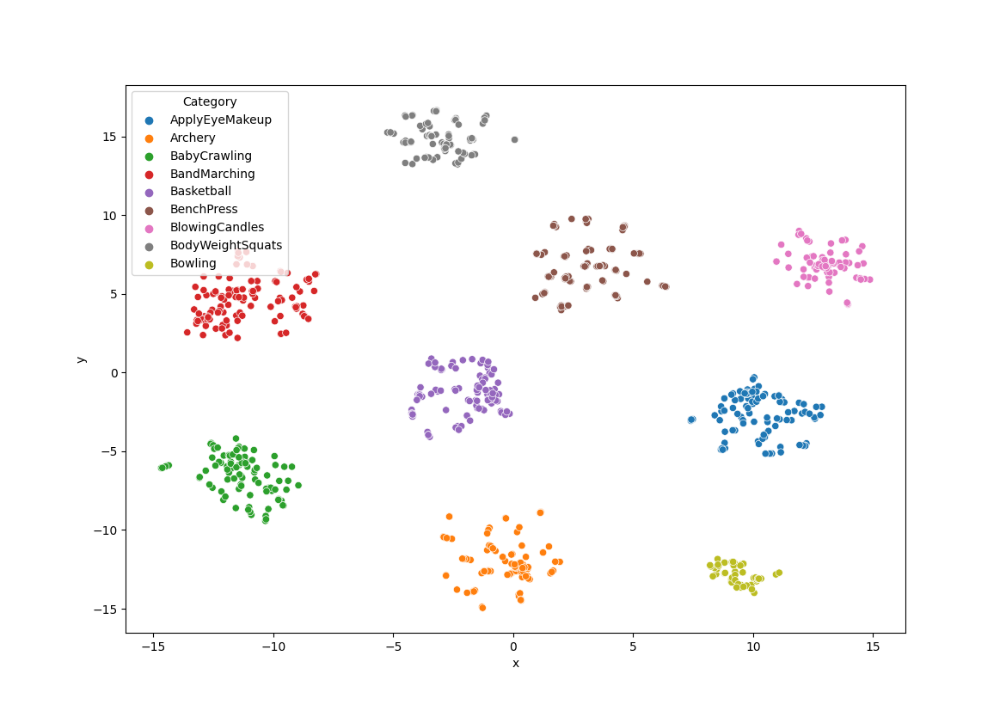
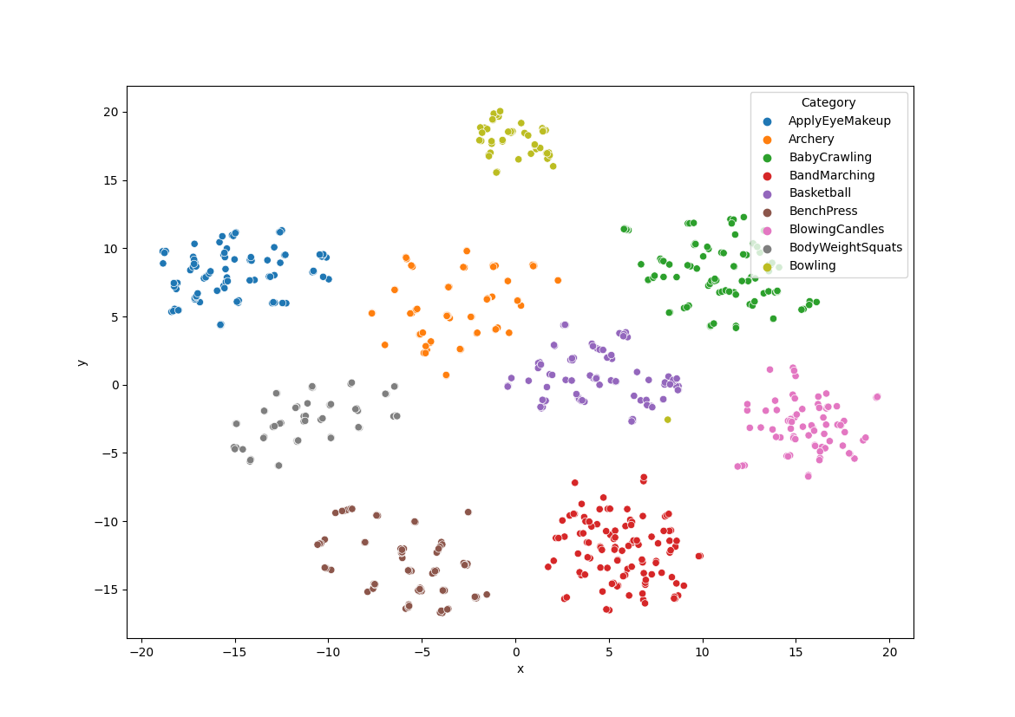
MViT
X3D

Slide 13
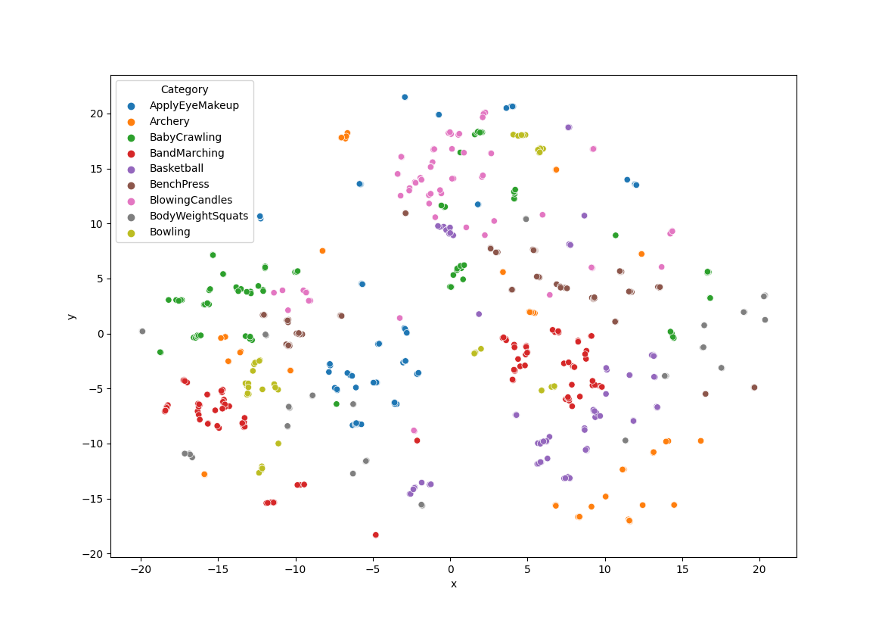
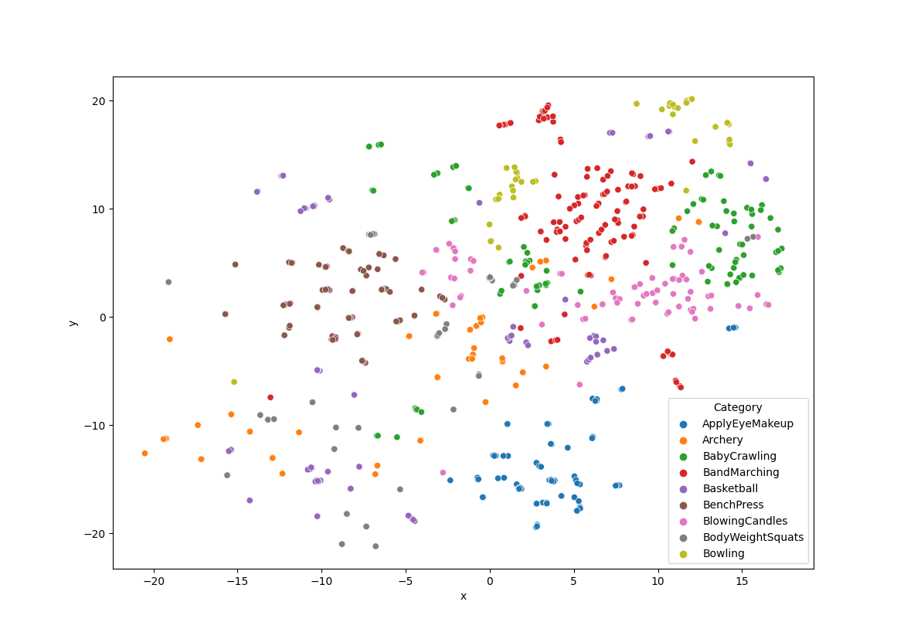
VIMPAC
VideoMAE

Slide 14
Experiments KNN Classification and Visualization
Generation of 2D representations with ScaNN (Google Research)
Compare classification performance based on nearest neighbors
As expected, supervised models perform much better
VideoMAE significantly better than VIMPAC
Visualization with t-sne
Supervised models have much more compact representations
Some representations denser than others (MViT vs. X3D)
VideoMAE seems to have more compact clusters than VIMPAC
Further ideas: • Inspect commonalities between outliers and “wrong” clusters
• Analyze relationships between clusters (basketball – football - baseball)

